Slide 1
Transcriptome Analysis of Spinal Tuberculosis in humans
GSE268366 · RNA-seq · Spinal TB vs Lumbar Disc Degeneration
Team G17
Amira Momtaz · 231001071 Inji Hatem Amin · 231000596 Habiba Essam Magdy · 231001460 Sara Ahmed · 231001837 Menna Khaled · 221000165 Tasabih Farid · 231001581
Supervised by TA: Dr. Shaimaa Roshdy Abdullah

Slide 2
Introduction
Tuberculosis is a highly infectious disease caused by Mycobacterium tuberculosis and is one of the top ten causes of death worldwide. Tuberculosis is most prevalent in developing countries and is generally treatable if detected early.

Slide 3
Abstract
Background
Objective
Key Findings
Spinal TB (Pott's disease) is a destructive form of extrapulmonary TB with severe neurological consequences. Molecular mechanisms remain poorly understood.
Investigate transcriptomic alterations in diseased intervertebral disc tissue using RNA-seq data (GSE268366) to identify molecular pathways and potential biomarkers.
Strong enrichment of immune & inflammatory pathways (cytokine signaling, TLR). Hub genes & proteins (TNFRSF family, complement proteins) identified as potential therapeutic targets.

Slide 4
Methodology — Data Collection
GEO Database · GSE268366
GEO Database
Samples
①
RNA-seq data retrieved from NCBI GEO under accession GSE268366 — spinal TB vs lumbar disc degeneration.
②
5 spinal TB patients (test group) vs 5 lumbar disc degeneration patients (control). Paired-end Illumina sequencing.
Data Type
Import in R
③
Bulk RNA-seq count matrix. FPKM normalized. Human reference genome GRCh38 alignment via TopHat2.
④
Data loaded into R environment. Gene expression matrix prepared for downstream QC and differential expression analysis.

Slide 5
Methodology — Differential Expression
DESeq2 · R Bioconductor
DESeq2 Workflow
Significance Thresholds
Raw count matrix imported into R
DESeqDataSetFromMatrix() used to build the model.
Counts normalized using DESeq2's median-of-ratios method.
Wald test for differential expression.
Cutoffs: adjusted p-value < 0.05 and |log₂FC| > 1.
Results exported for visualization & enrichment analysis.
Adj. p-value: < 0.05
|log₂FC|: > 1
R Packages Used
DESeq2
ggplot2
EnhancedVolcano
pheatmap
clusterProfiler
pathview

Slide 6
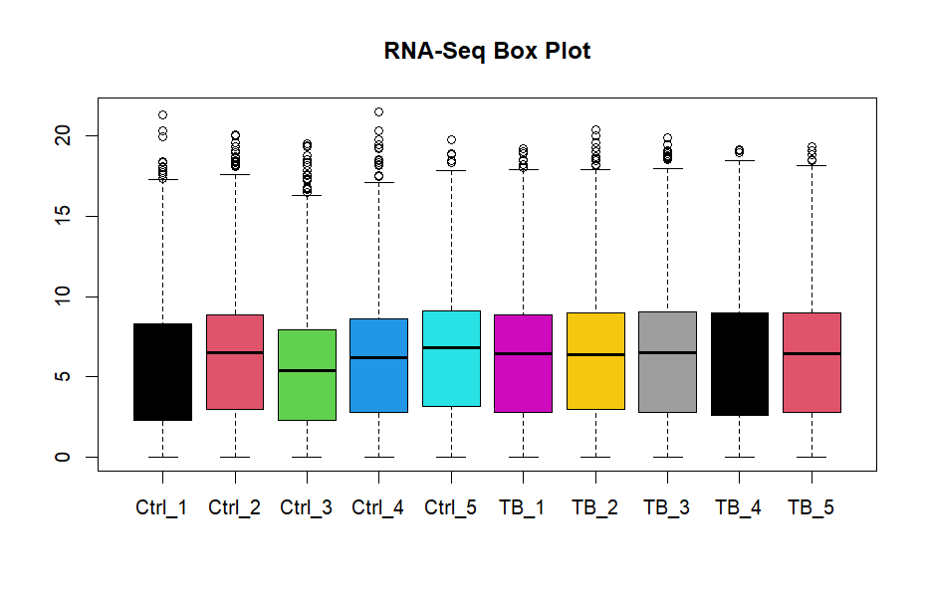
Quality Control — Box Plot
Quality Control — Box Plot
Distributions are relatively similar across all 10 samples.
Comparable interquartile ranges confirm acceptable normalization.
No major outlier samples detected.
Indicates data is ready for downstream differential expression.

Slide 7
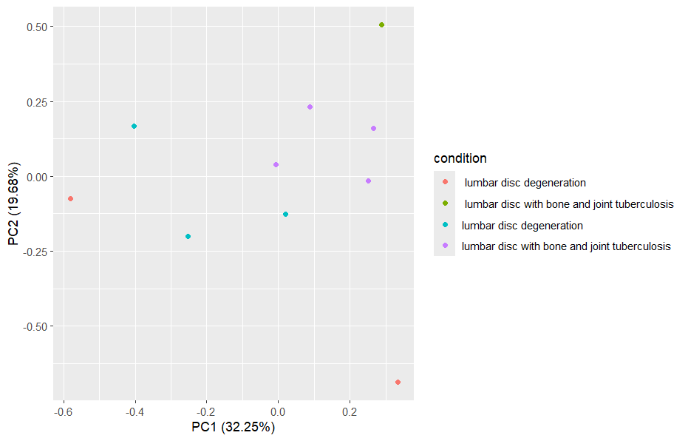
Quality Control — PCA
Interpretation
PC1 (32.25%) and PC2 (19.68%) capture majority of variance.
Moderate separation between TB and control groups visible.
Confirms biological differences between the two conditions.
Some overlap suggests inter-individual variation — expected with n=5.

Slide 8
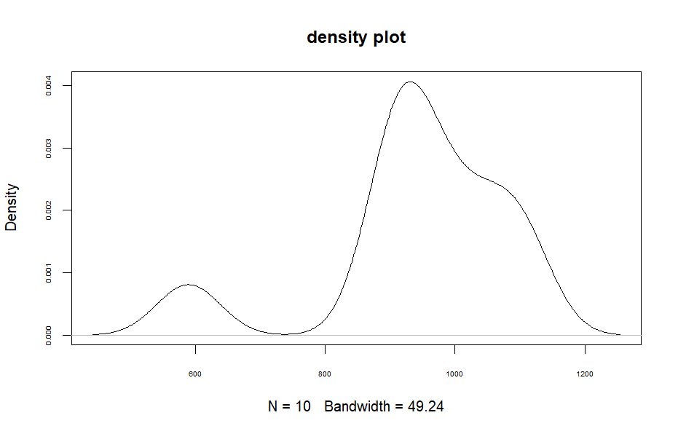
Quality Control — Density Plot
Interpretation
N=10 samples, bandwidth = 49.24
Bimodal distribution reflects two distinct gene expression clusters
Variability among samples is visible — expected in clinical data
Confirms the data spans a sufficient expression range for analysis

Slide 9
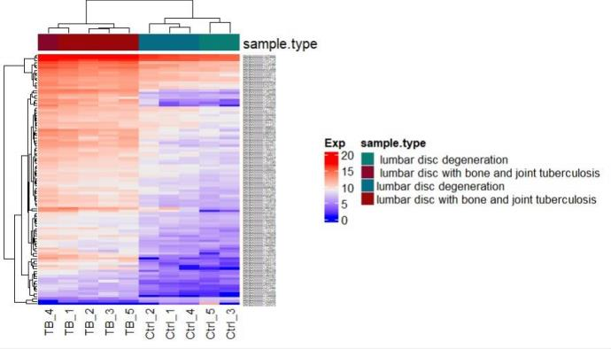
Results — Heatmap of Top 50 DEGs
Key Observations
Clear clustering of TB samples (red) vs control (blue).
TB samples show strong upregulation of immune genes.
Control samples show higher expression of structural/muscle genes.
Hierarchical clustering confirms two distinct transcriptomic profiles.
Top 50 DEGs show high inter-group contrast.

Slide 10
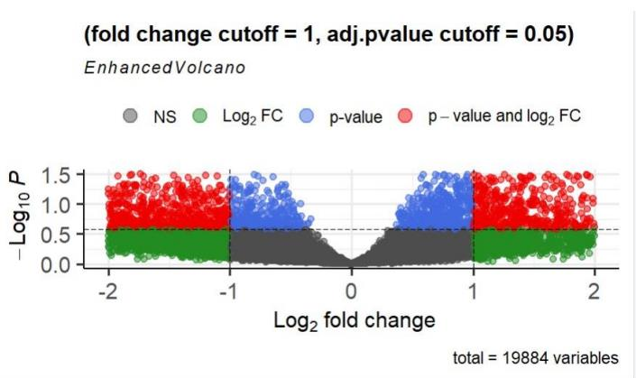
Results — Volcano Plot
Key Observations
Total genes: 19,884
Cutoffs: |log₂FC| > 1, adj.p < 0.05.
Red: significant by both p-value & FC.
Blue: significant by p-value only.
Green: significant by FC only.
Large number of significant DEGs confirms strong transcriptomic response to TB.

Slide 11
Results — Differential Expression Analysis
19,884
DEGs ↑
DEGs ↓
Total Genes analyzed
Upregulated
immune / inflammatory
Downregulated
structural / muscle
Notable DEGs
Gene
Direction
Function
CXCL9
↑ Upregulated
Promotes protective immune responses (chemokine)
CXCL10
↑ Upregulated
Recruits immune cells; promotes anti-TB immunity
IL1B
↑ Upregulated
Mediates inflammatory response; tissue regeneration
PLA2G2D
↑ Upregulated
Cell metabolism; immune cell infiltration regulator

Slide 12
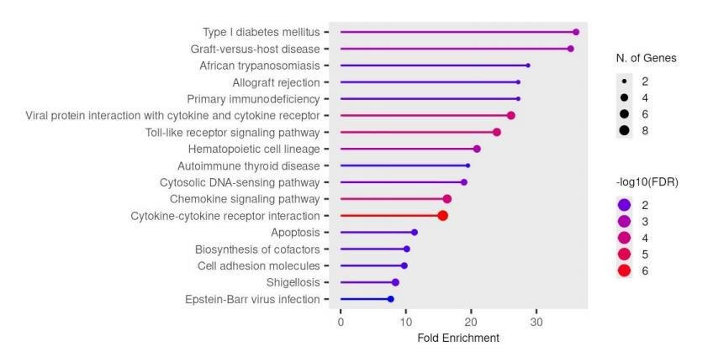
Functional Enrichment — KEGG Pathways
Top Enriched Pathways
Cytokine-cytokine receptor interaction.
Toll-like receptor signaling.
Chemokine signaling pathway.
Hematopoietic cell lineage.
Primary immunodeficiency.
Cytosolic DNA-sensing.
Cell adhesion molecules.
Apoptosis.
Dot size = N. of genes
Color = -log10(FDR)

Slide 13
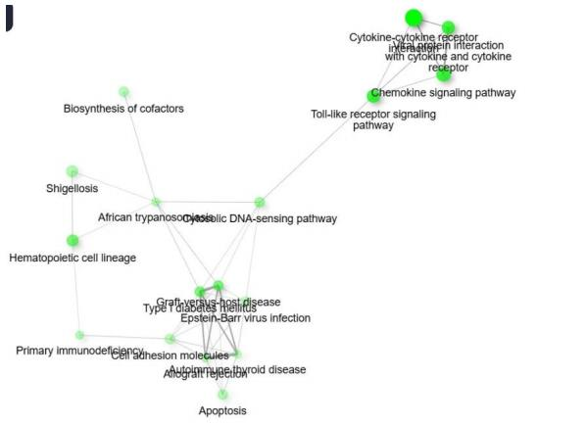
Functional Enrichment — GSEA & Enrichment Map
Enrichment Map Summary
GSEA identified gene sets enriched in immune and inflammatory programs.
Enrichment map shows strong clustering of cytokine & TLR pathways.
Nodes represent gene sets; edges indicate shared genes.
Central cluster: cytokine-cytokine receptor + TLR + chemokine pathways.
Confirms coordinated immune activation in spinal TB.

Slide 14
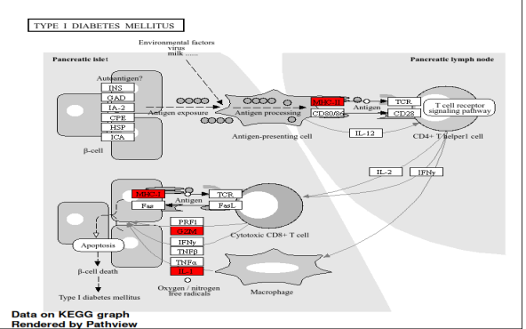
Biological Interpretation
KEGG Pathview — Type I Diabetes / Immune Signaling
Highlighted (red) genes are DEGs from spinal TB analysis.
M. tuberculosis triggers innate immunity via TLR & cytokine cascades.
TNF-α and IFN-γ pathways are key mediators of inflammation.
Immune evasion by M. tb disrupts adaptive immune crosstalk.
Upregulated CXCL9/10 indicate active T-cell recruitment.
IL1B upregulation promotes tissue damage and inflammation.

Slide 15
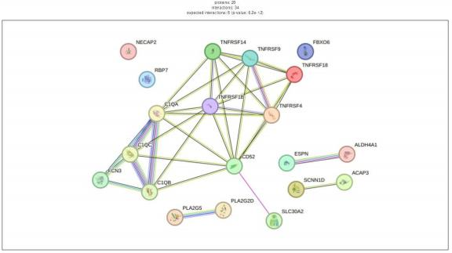
Protein-Protein Interaction Network
Hub Proteins Identified
TNFRSF Family
Key TNF receptor superfamily members — central to immune signaling.
C1QA / C1QB / C1QC
Complement proteins — innate immune activation
FCN3
Ficolin-3 — pattern recognition and complement activation

Slide 16

Conclusion
1
DEGs were predominantly associated with immune and inflammatory pathways — particularly cytokine-cytokine receptor interaction and TLR signaling.
2
Hub proteins (TNFRSF family, C1QA/B/C, FCN3) identified via PPI analysis represent potential diagnostic biomarkers and therapeutic targets.
Future Work
1
Healthy Control Group : Replace lumbar disc degeneration controls with clinically healthy tissue to eliminate confounding gene expression changes.
2
Animal Model Validation :Validate identified biomarkers (CXCL9, CXCL10, IL1B, TNFRSF) in in vivo tuberculosis bone infection models.

Slide 17
Thank You For Your Time !
Any Questions??

